Slide 1
Shark Attacks

Slide 2
Project Description:
Using the shark attack data to generate a dashboard that shows shark attack statistics by county when you click the country, the dashboard will also have table of all shark attack data in the dataset that the user will be able to filter, and finally there will be some additional charts to relations between various aspects of the data.

Slide 3
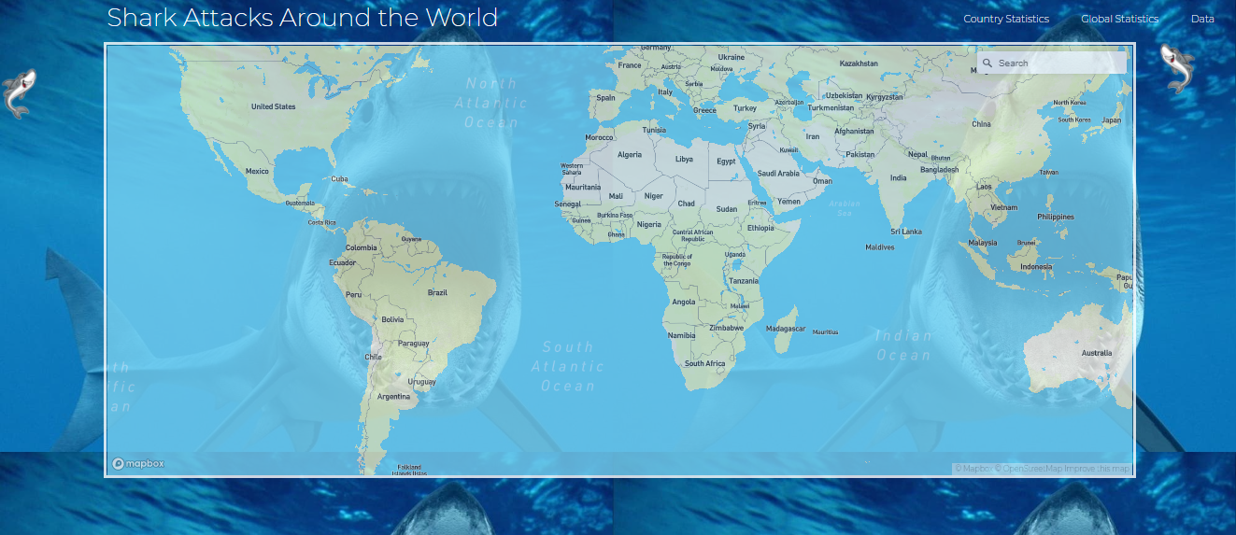
Dashboard:

Slide 4
Dashboard:
We have main dashboard where we can search multiple countries in map.

Slide 5
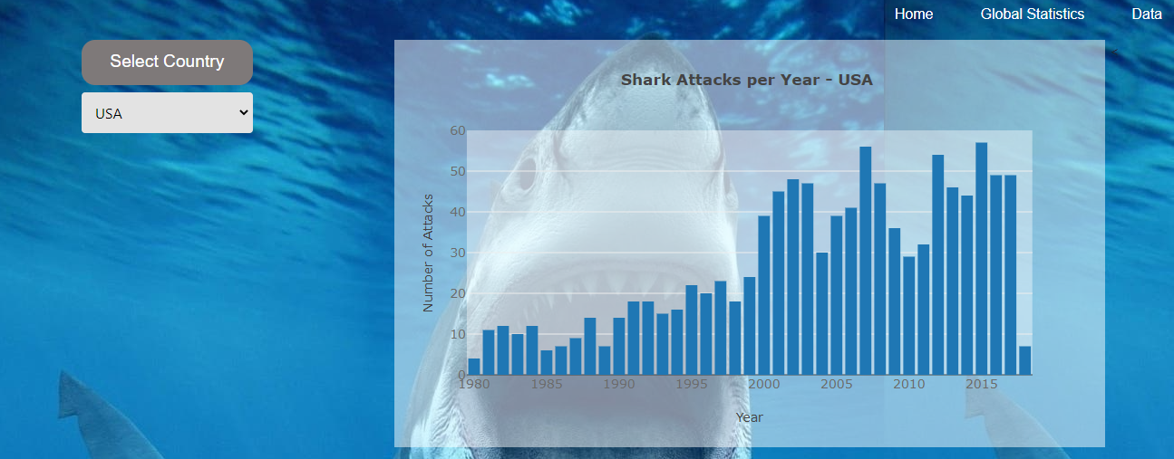
Country Stats: (Bar Chart)

Slide 6
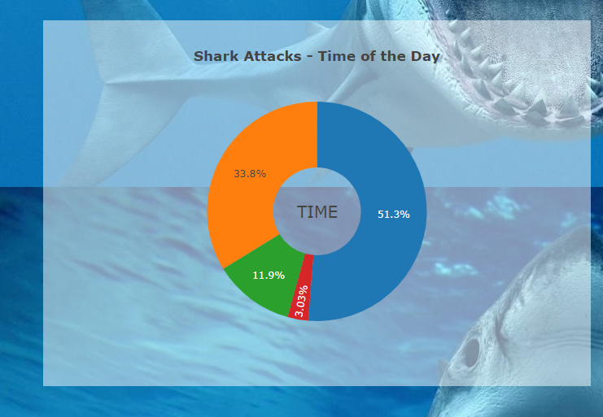
Country Stats: (Pie chart)

Slide 7
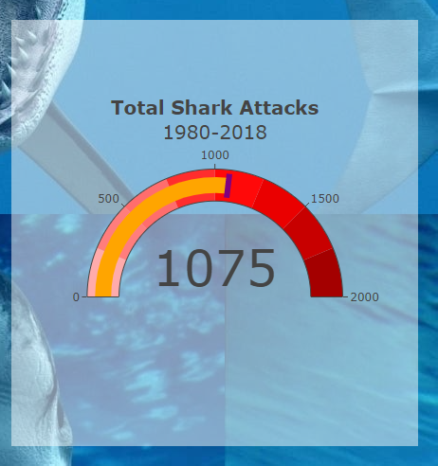
Country Stats: (Gauge)

